Slide 1
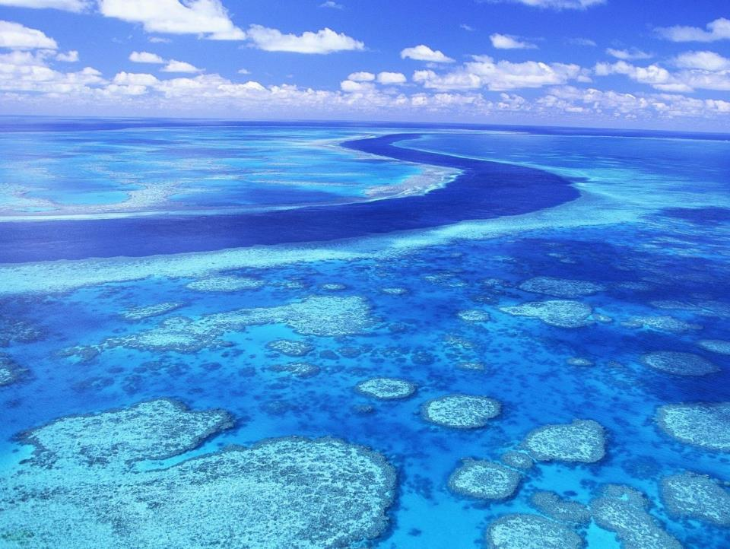
EART11100: Understanding the Earth
A dynamic Planet
Biogenic and chemical sediments

Slide 2
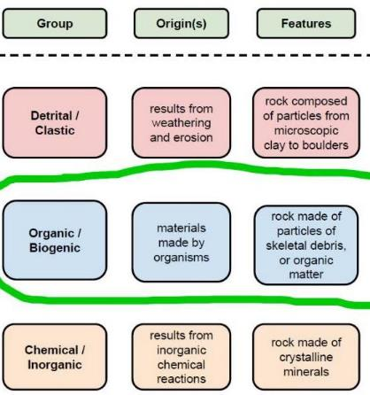

In this lecture…
Clastic sediment is derived from the erosion of pre-existing rock.
Other sediments include:
Biogenic sediments – those derived from the soft parts (“organic”) and hard parts (“skeletal”) of living organisms.
Chemical sediments – those precipitated directly out of water without the aid of organisms.

Slide 3
Organic muds (the sediment) and black shales (the rock)
Marine organic matter is largely the biomass of planktonic fauna and flora that live in the water column lakes and oceans.
  →Diverse chemical composition because derived from complex organisms
  →Proteins: animal tissue and enzymes
  →Carbohydrates: animal tissue
  →Lipids: algae, pollen, spores
  →Lignin: plant tissue (plant material can be washed into lakes and seas from land)
But these are typically dilute in most rocks:
  →Mudstones: 0.99 wt%
  →Carbonates: 0.33 wt%
  →Sandstones: 0.28 wt%

Slide 4
Organic muds (the sediment) and black shales (the rock)
Two fundamental factors control the occurrence of sedimentary organic matter:
The rate of organic productivity in the first place
  →Fundamentally relies on photosynthetic rate
→ Without photosynthesis, there never will be organic matter.
b) The rate at which the organic matter decays after death
→If this rate is greater than the rate at which organic material is produced, you will never preserve the organic material.
(Grossly simplified equilibrium reaction)
6CO₂ + 6H₂0 ↔ C₆H₁₂O₆ + 6O₂
Carbon dioxide Water Carbohydrate Oxygen
Photosynthesis
Respiration/combustion

Slide 5
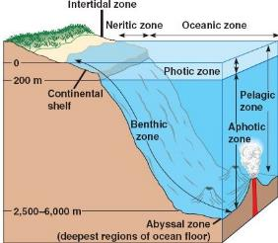
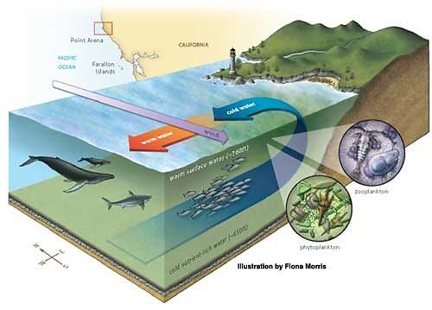
Organic muds (the sediment) and black shales (the rock)
Therefore high primary productivity largely occurs on land, and in the upper 200 m (the “photic zone”) of the ocean/lake
warm surface water
Primary productivity is also promoted by upwelling of cold, nutrient-rich ocean currents at continental margins
zooplankton
cold nutrient rich water
phytoplankton

Slide 6
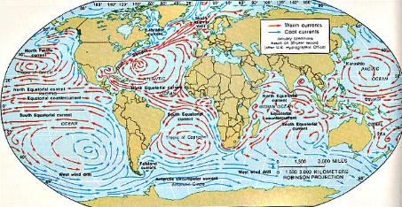
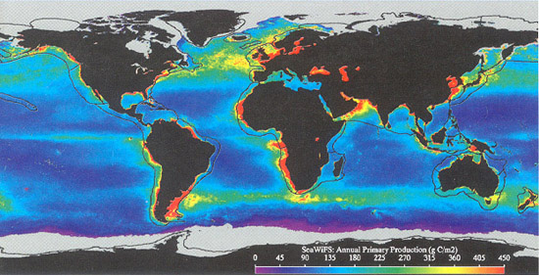
Organic muds (the sediment) and black shales (the rock)
Concentrated along the west coasts of continents in the present day.
Increased phyto-/zooplankton productivity

Slide 7
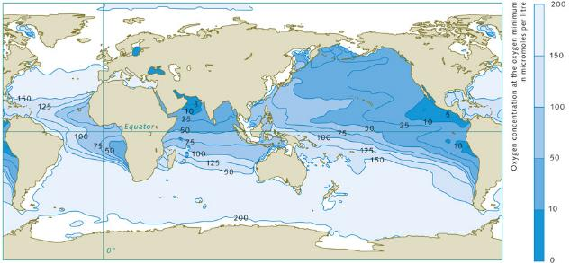

Organic muds (the sediment) and black shales (the rock)
Dead microorganisms settle on the seafloor, and decay according to
High supply of dead organisms to seafloor leads to O₂ demand > O₂ supply
Anaerobic layer forms in lower ocean and preservation of organic matter is possible.
Ocean stratification and organic preservation promoted by high productivity rates.
6CO₂ + 6H₂0 ↔ C₆H₁₂O₆ + 6O₂
Carbon dioxide Water Carbohydrate Oxygen

Slide 8
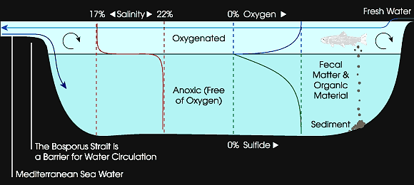
Organic muds (the sediment) and black shales (the rock)
Development of anoxic bottom waters are also promoted in restricted, poorly connected seaways and lakes
Dead organisms settle on sea/lake floor, and consume oxygen during decomposition.
Absence of major currents inhibit mixing of oxygen downwards, and an O2 concentration gradient quickly develops.
Stratification and organic preservation promoted by poor mixing.

Slide 9

Organic muds (the sediment) and black shales (the rock)
E.g. the Black and Baltic seas in the present day.

Slide 10
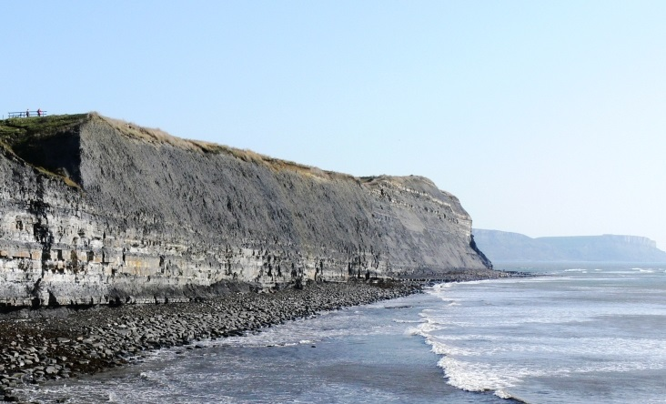
Organic muds (the sediment) and black shales (the rock)
To make rocks that are enriched in organic matter, an absence of clastic or carbonate sedimentation is preferable, since these “dilute” the organic matter.
Referred to as “source rocks”, because the organic matter degrades to kerogens, which are the source of oil and gas (Vicky’s lectures).
E.g. the Kimmeridge Clay (Middle Jurassic, c.155 Ma), here exposed in SW England, is a major source rock in the North Sea oil and gas fields.

Slide 11
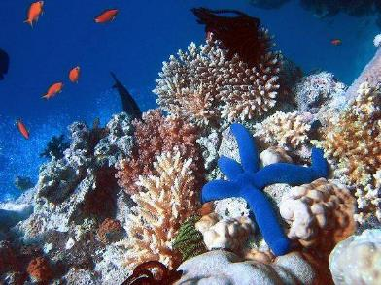
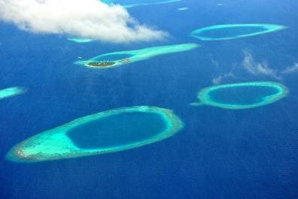
Carbonates
The major biological sediment, and sedimentary rock type generated in marine (and lake) settings are carbonates.
Carbonates are mainly limestone (CaCO₃) and dolomite (CaMg(CO₃)₂) (others exist).
  →precipitation largely mediated biologically, by the extraction of Ca, Mg, C and O dissolved in water.
Much less commonly, some organisms form shells from silica (SiO₂), e.g. radiolaria.
The skeletons are grown to provide the organism with a rigid structure, or to protect it (a home).

Slide 12
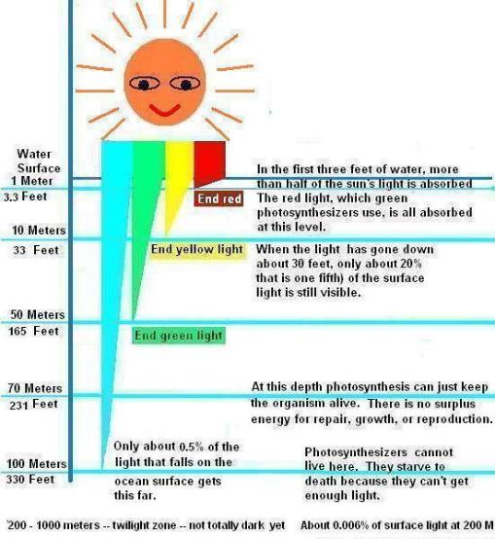
Carbonates
Because production is largely biologically mediated, production needs:
  →Light (the photic zone, absence of suspended mud)
  →Nutrients (usually land derived)
Additionally, organic growth is promoted by:
  →Warm water
and is inhibited by
  →unusual (low) pH
  →unusual salinities
Thus, carbonate is produced (primarily) in shallow marine environments

Slide 13
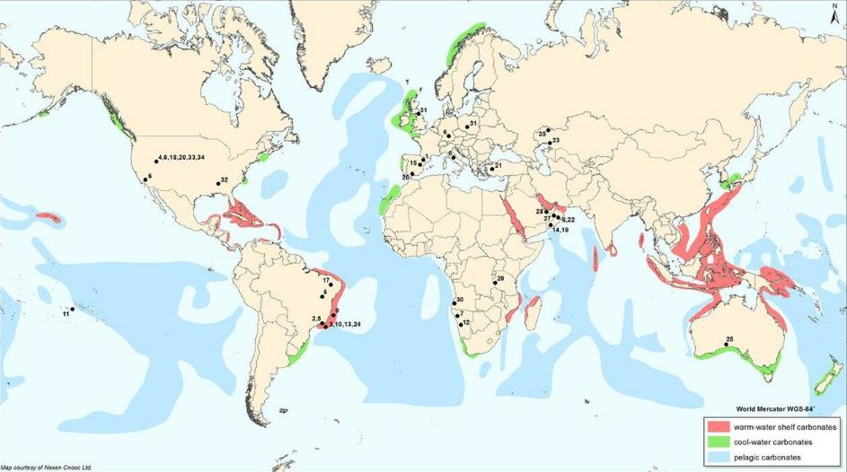
Carbonates
So carbonate “platforms” and “ramps”, form in shallow water shelves, where water is warm, has normal salinity, and and away from sources of clastic sediment input.
Global distribution of major sites of carbonate production. Areas in red “warm-water carbonates” are where carbonate production rates are highest.

Slide 14
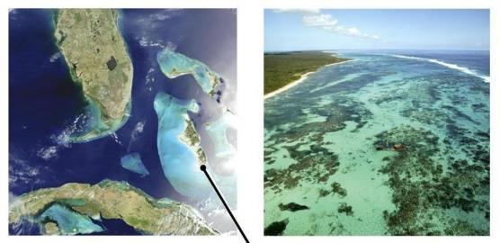
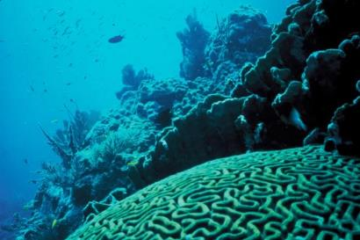
Carbonates
The carbonate material is formed by different organisms with different modes of life.
(I) IN SITU GROWTH
e.g. Bahamas Bank
  →This refers to carbonate that is precipitated by organisms which are fixed to the sediment substrate.
  →In the shallow, photic zone, these organisms constitute a “reef”, and when the organism dies, it may not move very far from the site in which it lived.

Slide 15
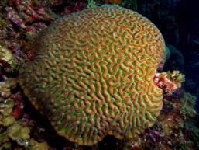
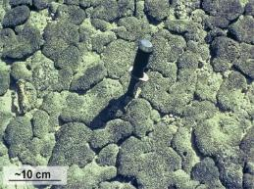
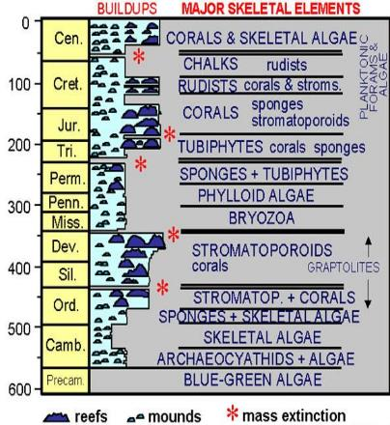
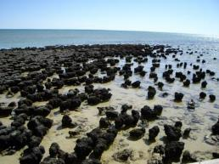
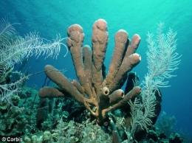
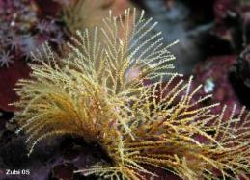
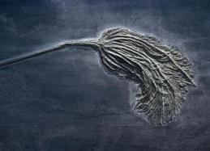
Carbonates
Corals
Algal Mats
Common in-situ reef-builders
  →Varied through geological time
Stromatoporoids
Sponges
Bryozoa
Crinoids

Slide 16
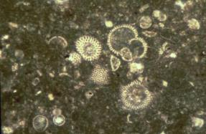
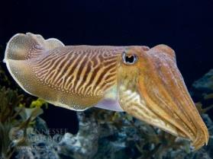
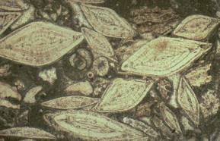
Carbonates
(II) PLANKTON, NEKTON AND BENTHOS
This refers to free moving organisms that could potentially contribute carbonate skeletal material to sediment
  →Plankton are those that drift (microorganisms are common: e.g. Algae, some foraminifera).
  →Nekton are those that swim (macroorganisms are common: e.g. Cuttlefish in the modern day).
  →Benthos are those that live on or in the sediment (many micro-types, e.g. some foramenifera, and macro-types, e.g. Gastropods, Bivalves)
Globigerinids
L. A.= 3 mm
Cuttlefish
Amphestegina benthic
foraminifera
L. A.= 3 mm

Slide 17
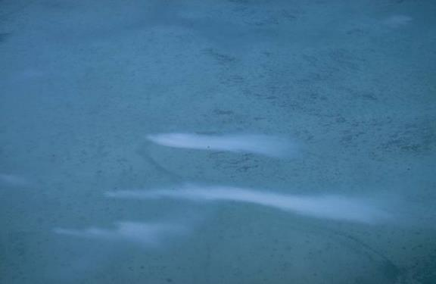
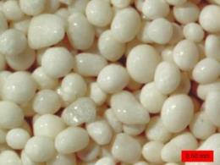
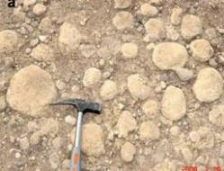
Carbonates
Inorganic precipitation of carbonate in the water column can sometimes happen
  →Called “whitings”
  →Not an overall major contributor of carbonate material
Carbonate can sometimes precipitate directly on to prexisting grain surfaces.
  →These are called “coated grains”
"Whitings" in the northern Belize shelf lagoon, elongated in a general east to west direction. The uppermost "whiting" is on the order of 300 m long.
Ooid/pesoid
Oncoid

Slide 18
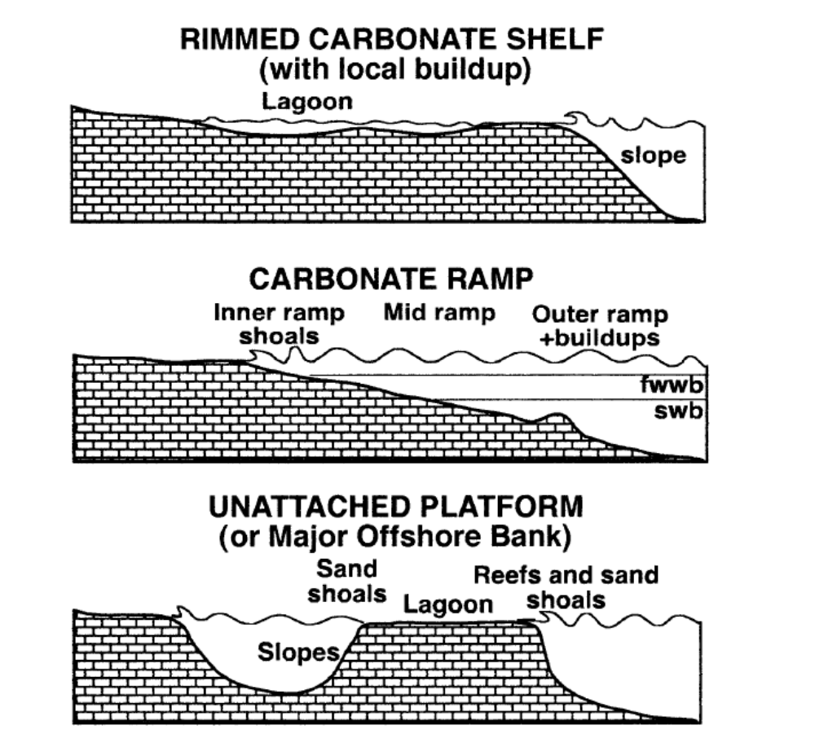
Carbonates
The environment of carbonate production and deposition are known as carbonate platforms.
They fall into three main classes:
Rimmed shelves
Isolated/unattached platforms (aka “atolls”).
Ramps
Bosence, 2005

Slide 19
Rimmed shelves
Rimmed shelves happen when
  → Carbonate production is HIGH
  → Water is warm, water is clear, water has a normal marine salinity.
Morphologically, they
  → are attached to land, and have
  → a flat top, with a distinct barrier reef,
  → a lagoon, behind, protected from waves by the reef
  → a steep slope in front of the reef into true “deep water”.

Slide 20
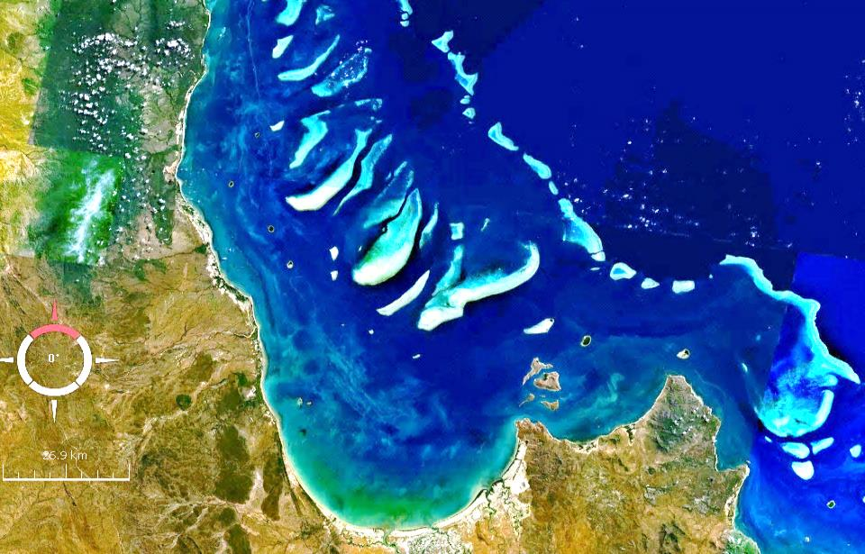
Rimmed shelves
Tidal channels
Patch reef
Barrier reef
Open marine
conditions
Tidal grainstone shoals
Lagoonal mudstone
The great barrier reef, Australia

Slide 21
Isolated platforms (“atolls”)
Isolated/unattached platform (or atolls) also happen when
  → Carbonate production is HIGH
  → Water is warm, water is clear, water has a normal marine salinity.
Morphologically, they
  → are not attached to land, (they are an island), and also have
  → a flat top, with a distinct barrier reef,
  → a lagoon, behind, protected from waves by the reef
  → a steep slope in front of the reef into true “deep water”.

Slide 22
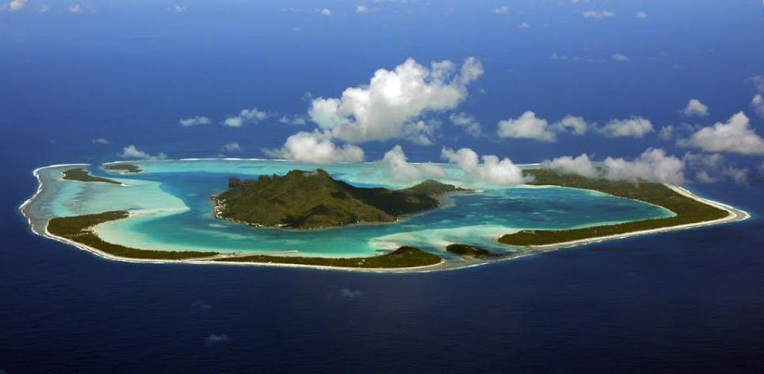
Isolated platforms (“atolls”)
Often, they form in the shallow water around a marine volcanic island
The land mass is not big enough to produce much clastic sediment, so they are good sites for carbonate productivity.
Bora Bora, French Polynesia

Slide 23
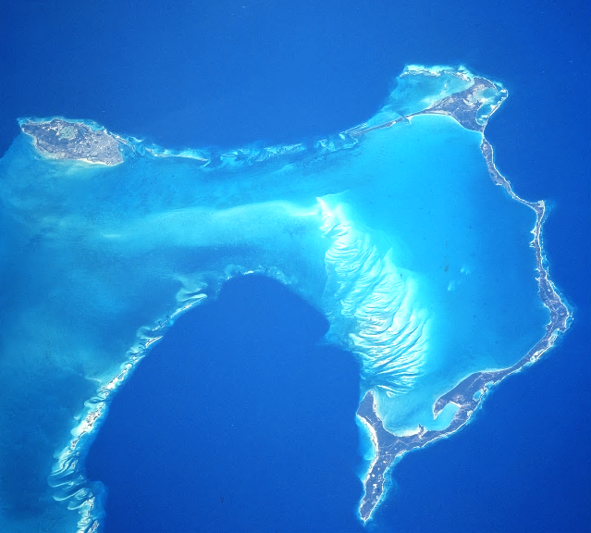
Isolated platforms (“atolls”)
High carbonate productivity means that the reefs can keep up with sea-level, if the volcano subsides, or sea-levels rise.
The lagoon is maintained, because the reef inhibits mixing of sea-water.
fringing reef
land
Ebb-flood
delta
lagoon
sand shoal

Slide 24
Carbonate Ramps
Carbonate ramps happen when
  → Carbonate production is LOWER
  → Water is cooler, water is contaminated by clastics, or the water is brackish or hypersaline (the carbonate platform is less “happy”).
Morphologically, they are characterised by
  A ramp that dips uniformly towards much deeper water
  No barrier reef, just local patches of reef in places
  Lower carbonate productivity means that the sediment is more readily reworked and moved away from shallow water by wave and tidal processes.

Slide 25
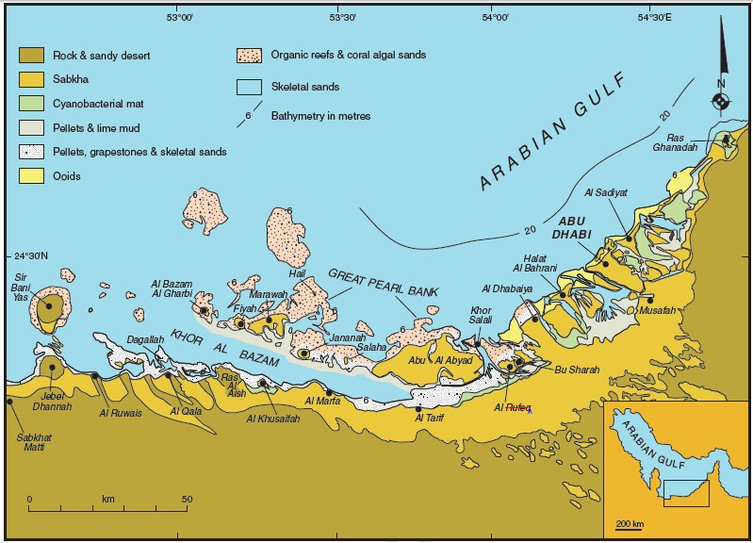
Carbonate Ramps
Trucial coast of the southern Arabian Gulf.

Slide 26
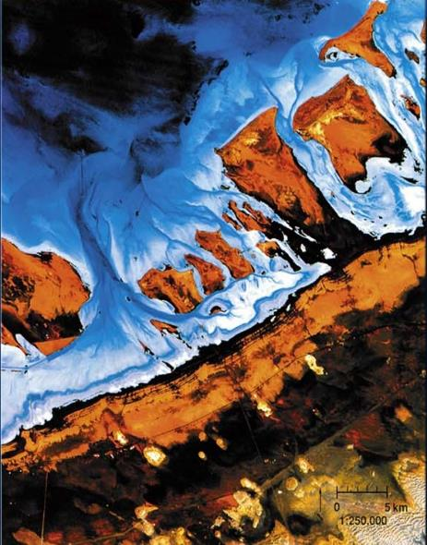
Carbonate Ramps
Here, carbonate productivity is limited by poor circulation and high temperatures, in the Arabian Gulf
  →Promote hypersalinity in the water.
Carbonate production is limited to a few reefs, and bacterial and algal mats forming in intertidal areas.
Lack of good barrier means that waves and tidal processes break up material and transport it away to deeper water.
sabkha
aeolian

Slide 27
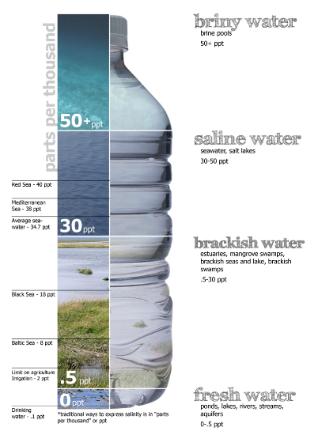
Evaporites
Chemical sediments are precipitated directly from sea and lake water
  → without being mediated by biogenic activity
  →it is wholly inorganic.
Direct precipitation of dissolved minerals from seas and lakes occurs because the water becomes supersaturated with respect to that mineral.
How does this supersaturation happen?

Slide 28

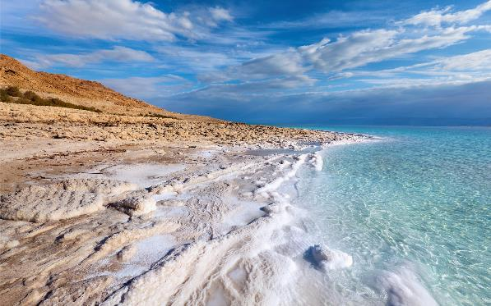
Evaporites
In areas of excess evaporation, versus inflow of fresh (rain) water from rivers, dissolved minerals become hyperconcentrated.
These minerals are predominantly minerals of common Earth surface metals
  Calcite and polymorphs (CaCO₃) and dolomite (CaMg(CO₃)₂)
  The salt group (Halogens) – NaCl (halite), KCl (sylvite), MgCl, etc.
  Gypsum (CaSO₄·2H₂O) and anhydrite (CaSO₄).
The Dead Sea has is hyperconcentrated in halite (table salt), at 40ppm (5ppm more than normal oceans). This is enough to promote inorganic precipitation of salt.

Slide 29
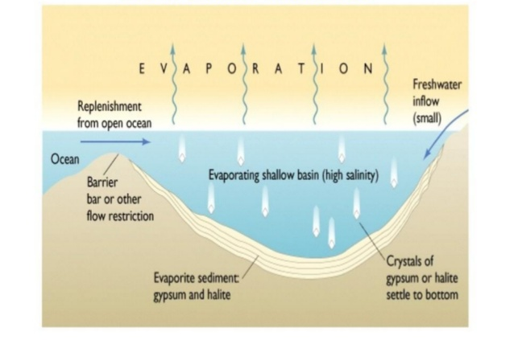
Evaporites
If Oceans were perfectly mixed, these pools of hyperconcentrated water would be mixed around.
However, hypersalinity develops readily in
  seaways (and especially lakes) that have poor/no connection to the open ocean,
  and experience an excess of evaporation versus inflow of fresh water.

Slide 30
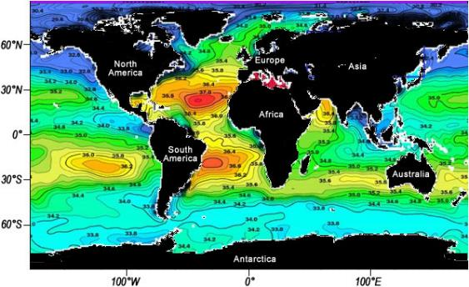
Evaporites
Two subtropical belts of elevated salinity tell you that the Atlantic is not fully mixed.
The Mediterranean has elevated salinity because evaporation>rainfall and it is poorly connected to the Atlantic
The Bay of Bengal is very fresh because of the high freshwater discharge of the Ganges.

Slide 31
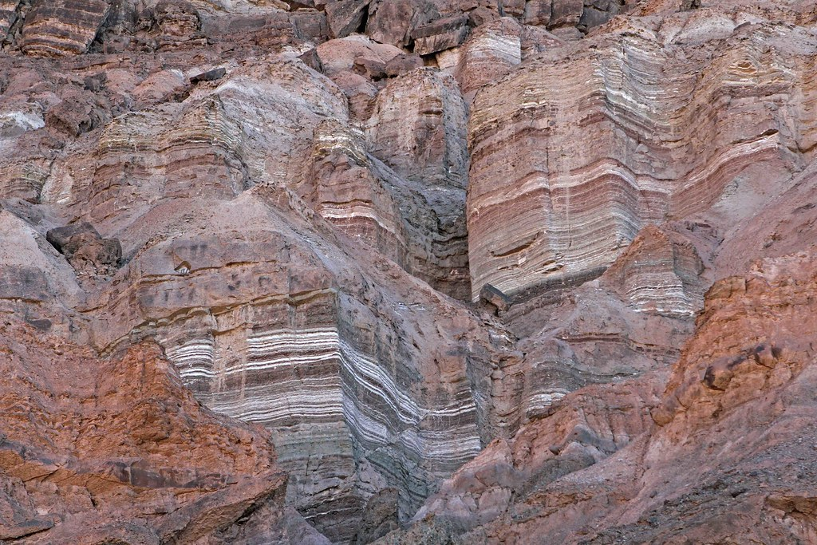
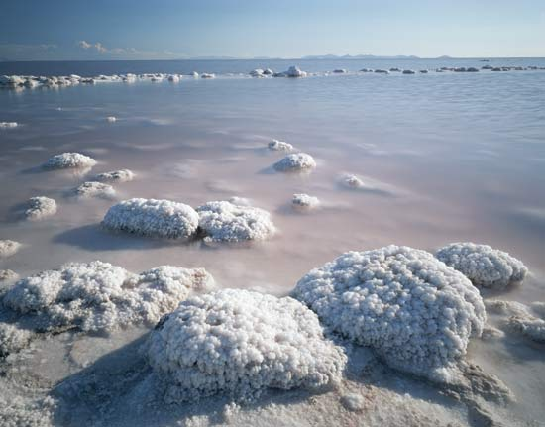
Evaporites
Therefore, evaporite deposits are good palaeoclimate and palaeogeographic indicators
  →If they are preserved in the sedimentary record, they tell you that conditions were arid, and that the body of water was closed off or had restricted connection to the open ocean.
Evaporite deposits, Death Valley. These are mainly Gypsum, intestratified with clastic clay which also entered the lake/sea. Halite (salt) and anhydrite rarely ever outcrop because they are so soluble in rainwater.
Great Salt Lake, Utah, is currently precipitating salt.

